Slide 1


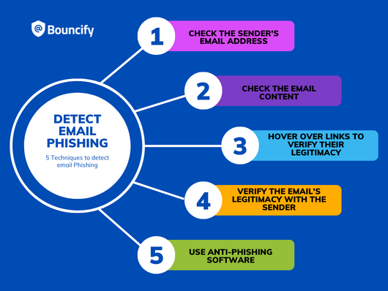
CAPSTONE PROJECT I
FRAUD DETECTION
Spam vs. Ham Emails
PRESENTED BY –
PRINCE PAL SINGH – 0854378 ( TEAM LEAD)
ANKITA VASHISHT – 0854392 (TEAM MEMBER)
KARAN – 0850990 (TEAM MEMBER)
SWATI KUMARI – 0850708 (TEAM MEMBER)

Slide 2
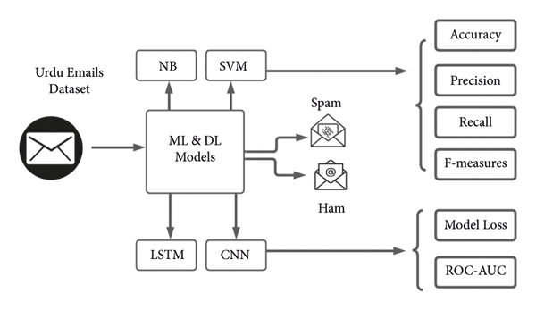
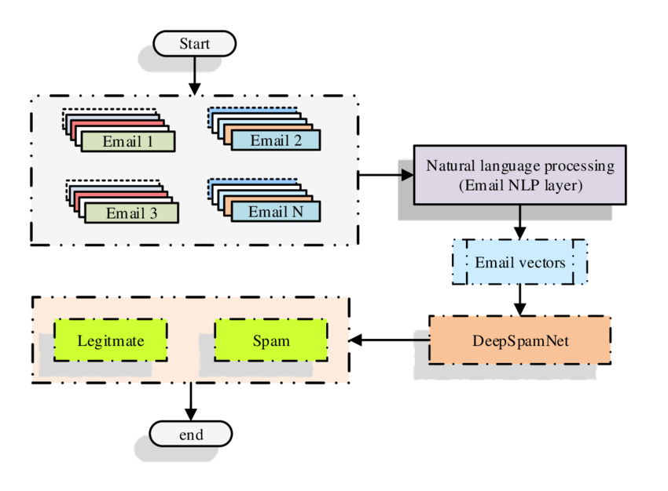
TOPICS
WHY EMAIL SPAM FRAUD DETECTION?
CAFC (CANADIAN ANTI-FRAUD CENTRE )
INTRODUCTION
TYPES OF FRAUDS
BENEFITS AND IMPACT ?
CHALLENGES AND FUTURE PERSPECTIVE:
DATASETS
VISUAL REPRESENTATION OF THE DATASET
MACHINE LEARNING ALGORITHMS
RNN(RECURRENT NEURAL NETWORKS)
ABOUT RNN
DATA PRE-PROCESSING
TRAINING AND TESTING
CODE

Slide 3
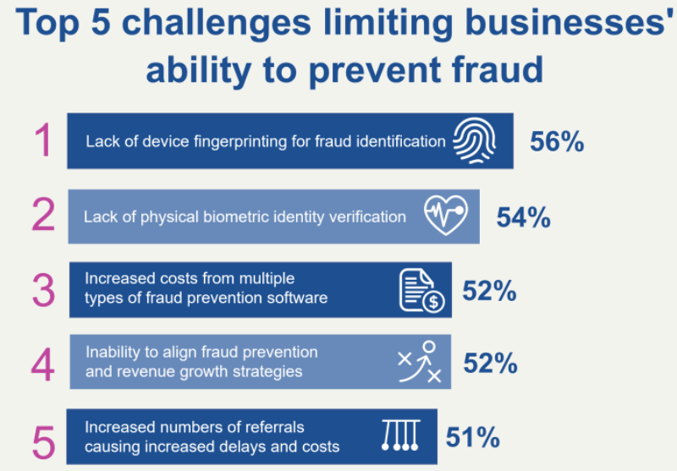
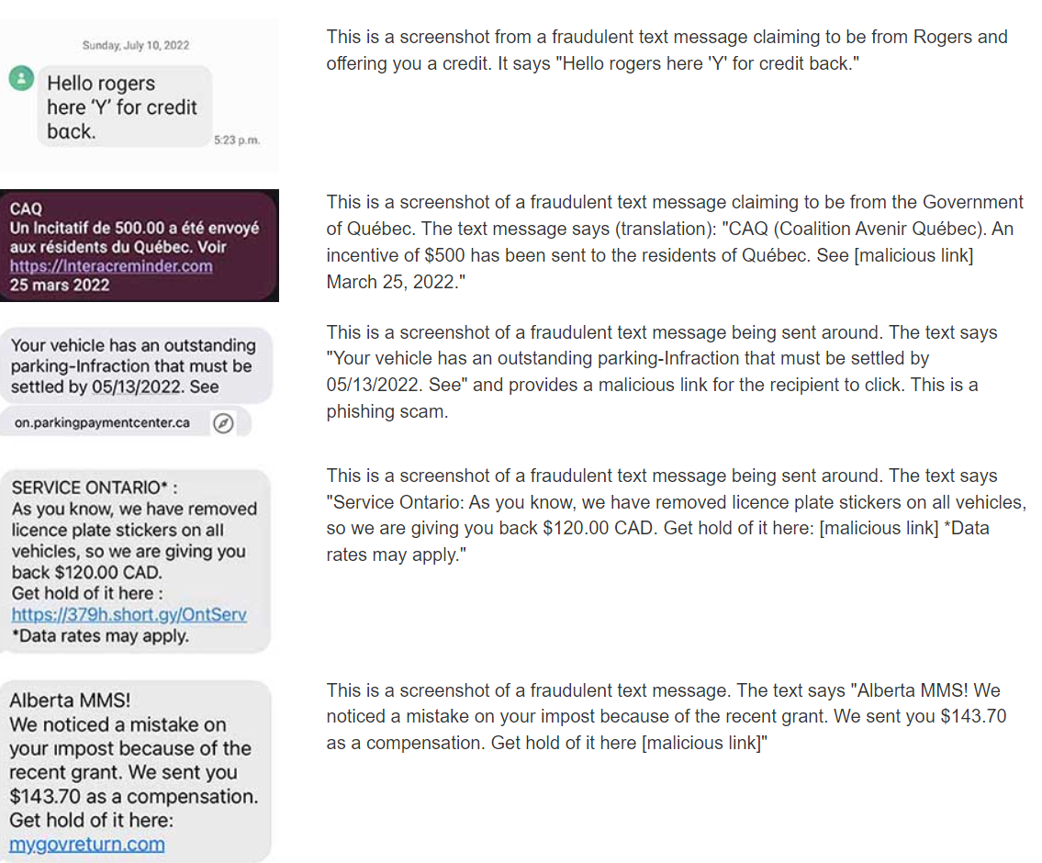
WHY EMAIL SPAM FRAUD DETECTION?
SOME OF THE ISSUES ADDRESSED IN CANADA:
High Volume of Spam: Spam remains a significant issue globally, constituting 45% of all email communications. This trend has persisted into the fiscal year 2021-2022.
Increase in Spam Reports: In 2021-2022, Canadians submitted 322,345 spam reports to the Spam Reporting Centre, marking a 12.9% increase from the previous year.
Rise in Spam Texts: There has been a notable increase in spam and fraudulent text messages. In the last year, 5,395 text messages were reported to the Canadian Anti-Fraud Centre, with nearly $24 million lost to fraud initiated via text messages.
REFERENCE - https://ised-isde.canada.ca/site/office-consumer-affairs/en/identity-theft-spam-and-fraud/mail-fraud-and-spam
https://antifraudcentre-centreantifraude.ca/scams-fraudes/phishing-hameconnage-eng.htm
https://www.theglobeandmail.com/canada/article-top-scams-fraud-canada/
SOME FRAUD REPORTED TO Canadian Anti-Fraud Centre (CAFC)

Slide 4
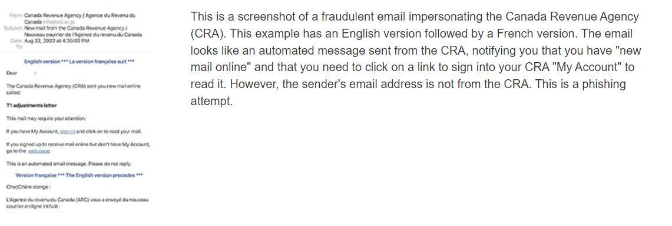
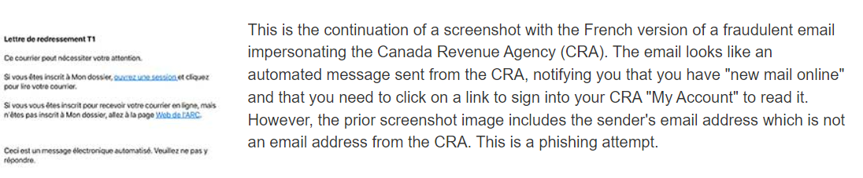
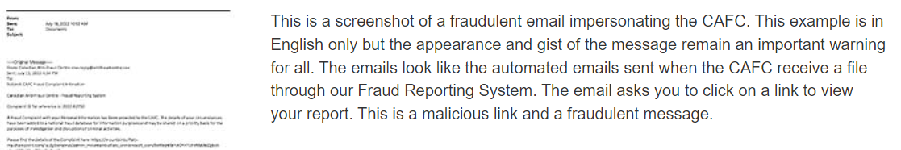
EMAIL SPAMS REORTED TO CAFC
(Canadian Anti-Fraud Centre )

Slide 5
INTRODUCTION
WHAT IS FRAUD(SPAM) DETECTION ?
Fraud detection in the context of spam emails involves identifying and filtering out emails that are not only unsolicited but also potentially harmful or deceptive. This process is crucial for protecting users from phishing attacks, malware, and other fraudulent activities.
Fraud detection in spam emails refers to the identification and filtering of emails that are designed to deceive recipients into providing sensitive information, downloading malware, or engaging in other harmful activities. This is important for maintaining the security and integrity of email communication systems.
- Productivity Loss
- Financial Costs
- Security Risks
- System Performance
- Reputational Damage
- Missed Opportunities
- Resource Allocation
- Legal and Regulatory Issues
- Customer Trust
- Operational Disruption
IMPACT OF SPAM EMAILS ON BUSINESSES

Slide 6
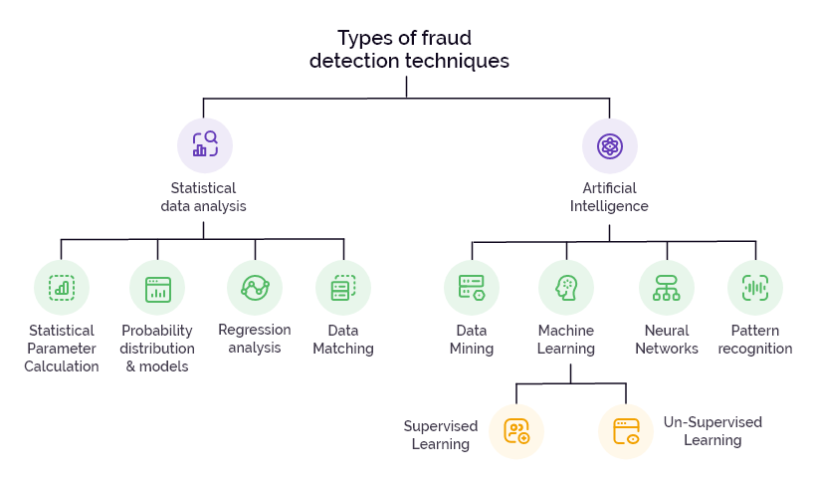
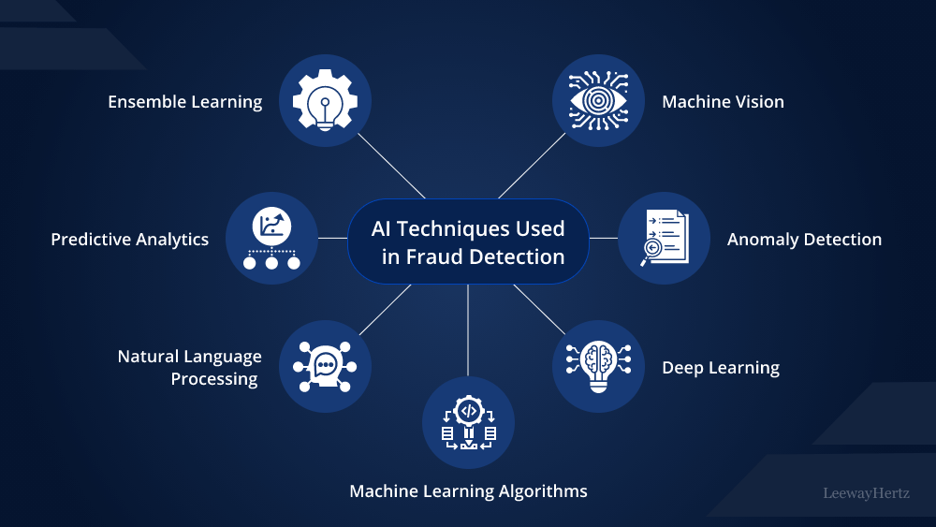
TYPES OF FRAUDS
FRAUDS REFER TO PHISHING, MALWARE DISTRIBUTION, SPOOFING, BUSINESS EMAIL COMPROMISE (BEC), etc.
Email Spam: Unsolicited commercial emails involving mass mailing
Messaging Spam: Repeated unsolicited messages in messaging systems.
Social Media Spam: Fake posts and comments to promote products or services.

Slide 7
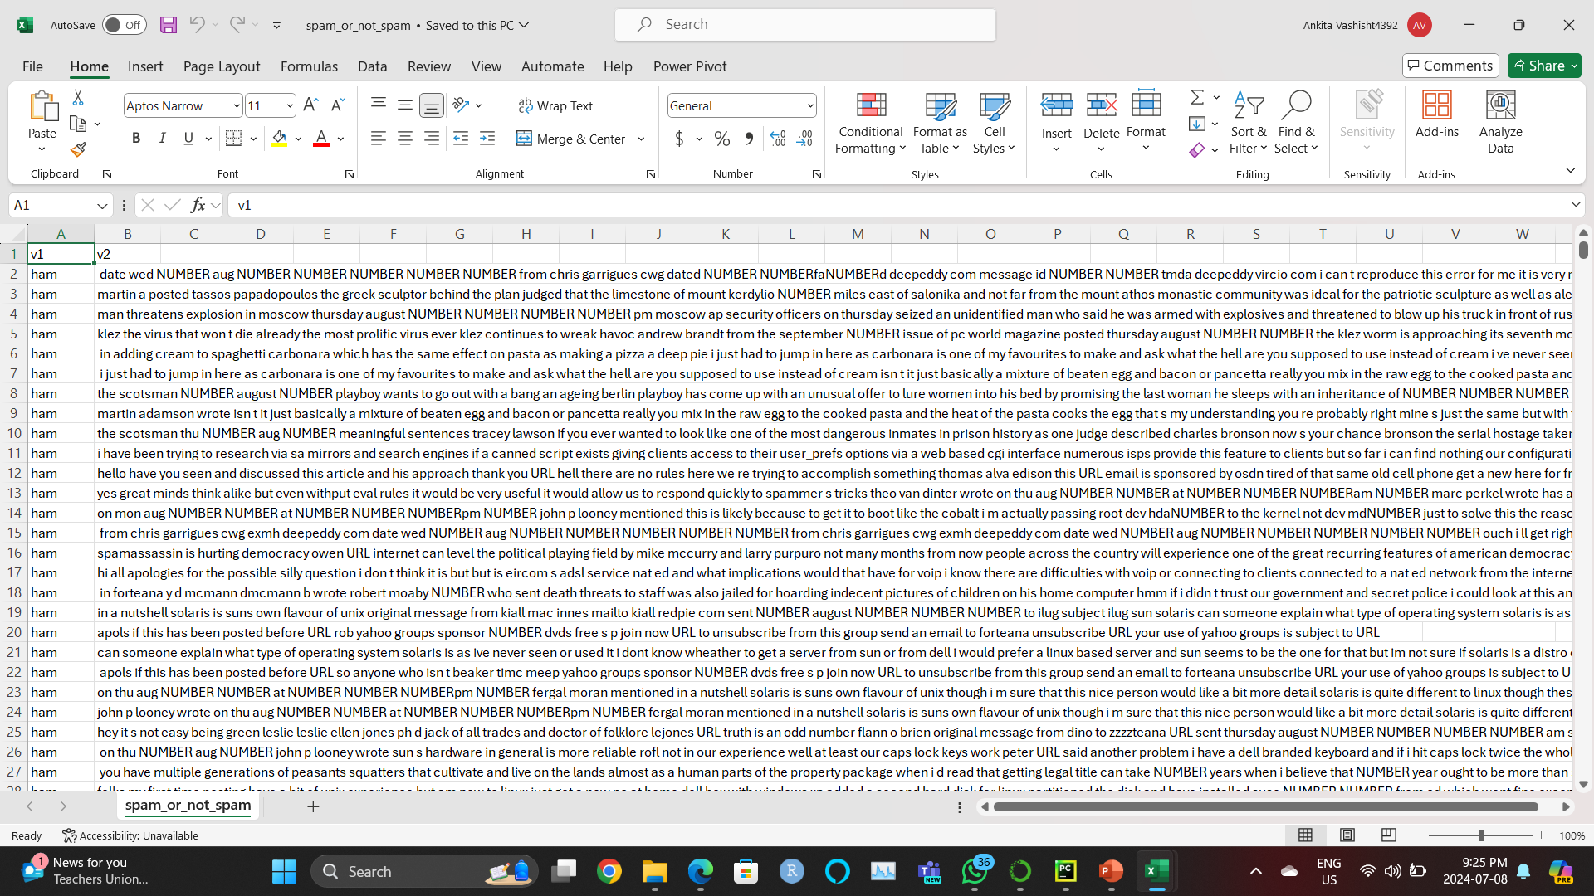
DATASETS

Slide 8
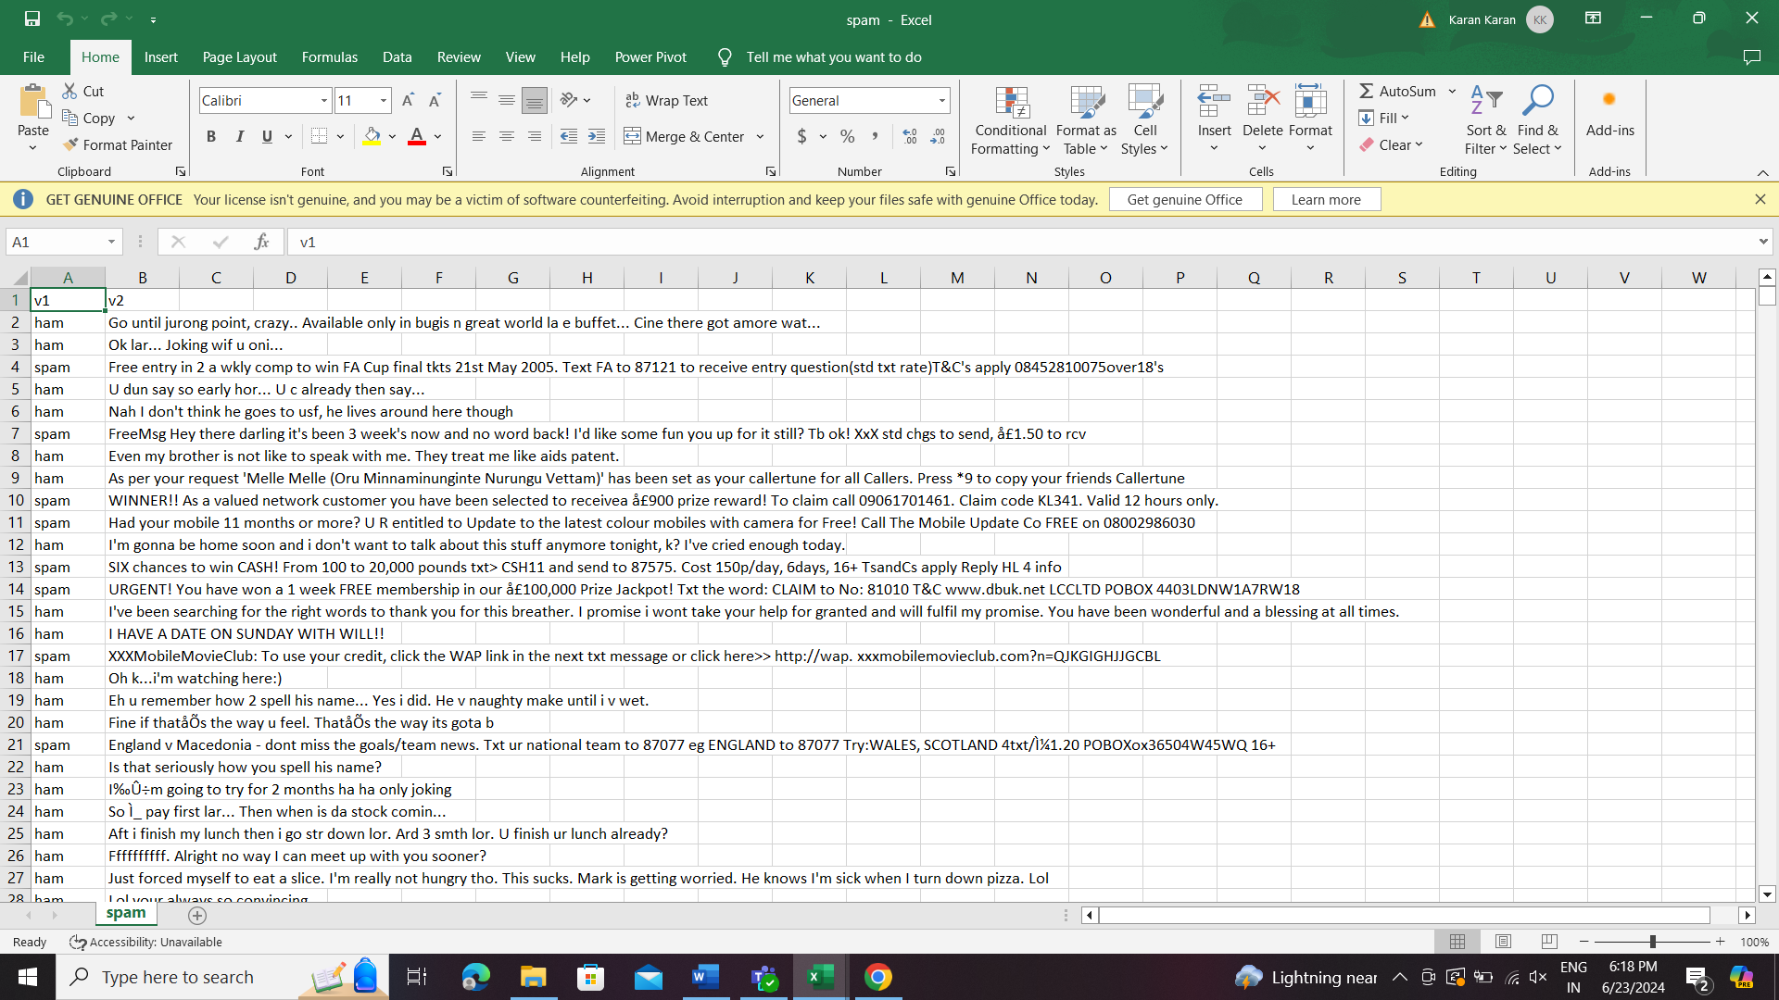
DATASETS
THE HAM – SPAM DATASET :
This dataset can be valuable for various types of projects, especially those related to natural language processing (NLP), text classification, and machine learning. Here are a few reasons why it might be useful:
Spam Detection: If your project involves creating or improving a spam detection system, this dataset is ideal as it provides labeled examples of both spam and non-spam messages.
Text Classification: This dataset allows for the exploration of different text classification techniques and algorithms, such as logistic regression, decision trees, random forests, support vector machines, and neural networks.
Natural Language Processing: The SMS messages can be used to practice NLP tasks such as text preprocessing (tokenization, stemming, lemmatization), feature extraction (TF-IDF, word embeddings), and model evaluation.
Supervised Learning: Since the dataset is labeled, it is suitable for supervised learning approaches where you train a model on labeled data and evaluate its performance.
Imbalanced Data Handling: The dataset may provide an opportunity to work with imbalanced data (if the ratio of ham to spam messages is not equal), which is common in real-world datasets.
Columns:
v1: This column contains the labels, indicating whether a message is "ham" or "spam.“
v2: This column contains the text of the SMS messages.
Unnamed: 2, Unnamed: 3, Unnamed: 4: These columns contain mostly NaN values and seem to be unnecessary for the analysis.
Rows:
The dataset contains 5572 entries.
The majority of the data is in the first two columns (v1 and v2), with the other columns being mostly empty.
The dataset provided appears to be a collection of SMS messages labeled as either "ham" (non-spam) or "spam." Here is a brief overview of the dataset:

Slide 9
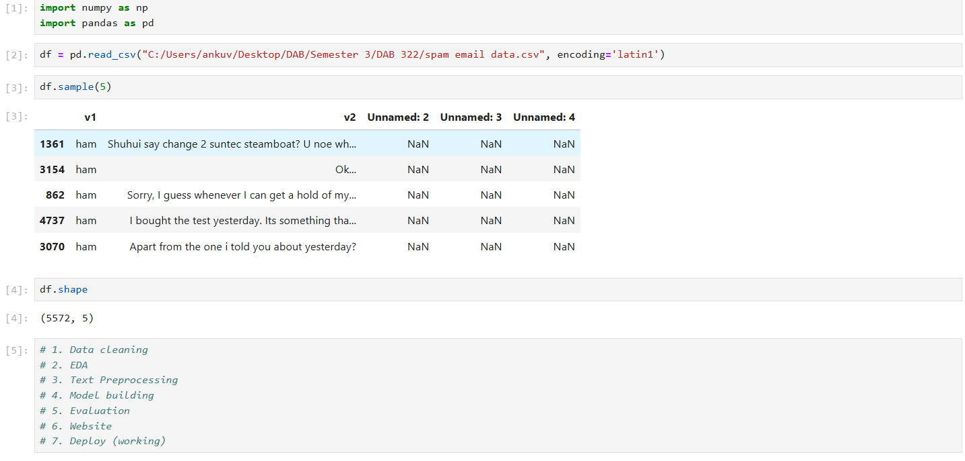
Import Libraries: The numpy library is imported for numerical operations and pandas for data manipulation and analysis.
Loading the dataset
This line displays 5 random rows from the dataframe df. This is useful for quickly inspecting the data to understand its structure and content
These are the further steps

Slide 10
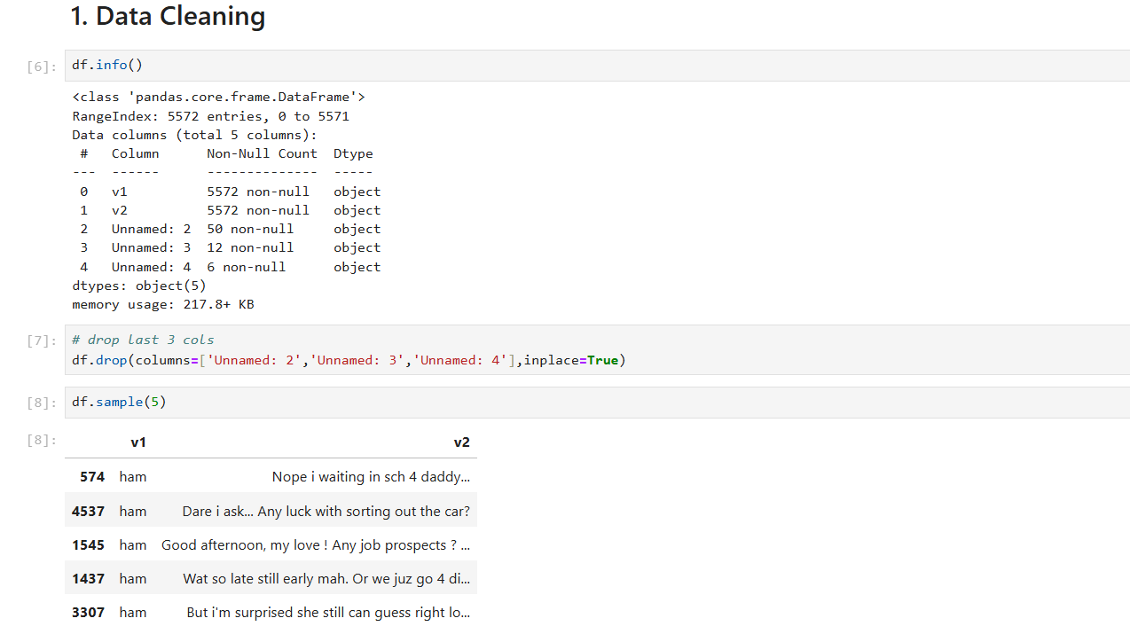
This line displays a concise summary of the Data Frame, including the number of entries (rows), columns, non-null counts, and data types. This is useful to get an overview of the data and check for missing values.
The Data Frame has 5572 entries and 5 columns.
Columns 'v1' and 'v2' have no missing values (5572 non-null).
Columns 'Unnamed: 2', 'Unnamed: 3', and 'Unnamed: 4' have a significant number of missing values and are not needed for spam classification.
This line removes the unnecessary columns 'Unnamed: 2', 'Unnamed: 3', and 'Unnamed: 4' from the DataFrame. The inplace=True parameter ensures that the changes are made directly to the original DataFrame without needing to reassign it.
This line displays 5 random rows from the cleaned DataFrame. This helps to verify that the unnecessary columns have been successfully removed and to inspect the remaining data.

Slide 11
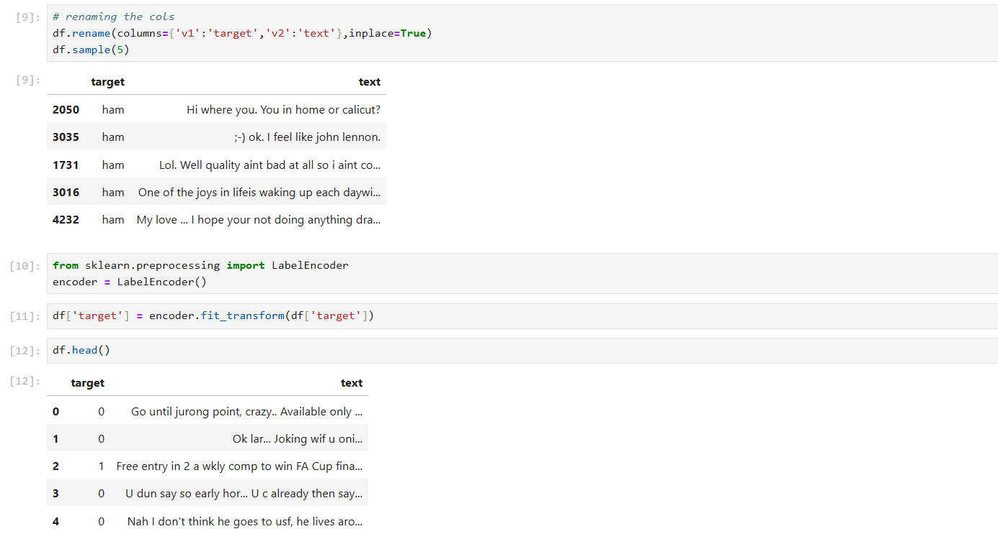
This line renames the columns of the DataFrame to more descriptive names. 'v1' is renamed to 'target' (representing the label: ham or spam), and 'v2' is renamed to 'text' (representing the text content of the email). The inplace=True parameter ensures that the changes are made directly to the original DataFrame without needing to reassign it.
This line displays 5 random rows from the DataFrame with the newly renamed columns. This helps to verify that the columns have been renamed correctly.
These lines import the LabelEncoder class from sklearn.preprocessing and initialize an instance of it. Label encoding is used to convert categorical labels (ham, spam) into numerical values (0, 1).
This line uses the LabelEncoder to fit and transform the 'target' column. It converts the categorical labels (ham, spam) into numerical values (0, 1) and updates the 'target' column with these numerical values.
This line displays the first 5 rows of the DataFrame to verify that the label encoding has been applied correctly.

Slide 12
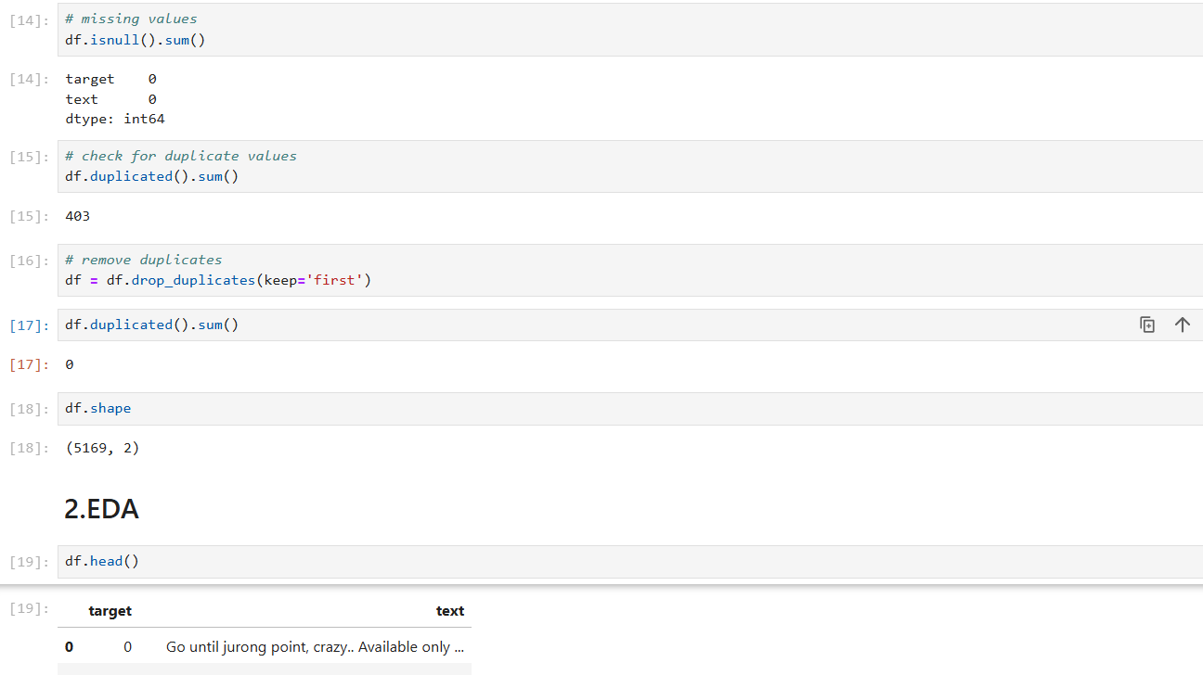
df.isnull():
This method checks each element in the DataFrame to see if it is NaN (Not a Number), which represents a missing value. It returns a DataFrame of the same shape with boolean values (True if the element is NaN, False otherwise).
sum():
After identifying the NaN values, the .sum() method is used to sum up all the True values in each column. Since True is treated as 1 and False as 0, the sum gives the total count of missing values in each column.
df.duplicated():
This method returns a boolean Series where each value indicates whether a row is a duplicate (True) or not (False).
.sum():
Summing the boolean Series gives the total number of duplicate rows, as True is treated as 1 and False as 0.
df.drop_duplicates(keep='first'):
This method removes duplicate rows from the DataFrame.The keep='first' parameter ensures that the first occurrence of a duplicate row is kept, and subsequent duplicates are removed.
The DataFrame df is reassigned to the result of this operation to ensure the duplicates are removed.
This step rechecks the DataFrame for duplicates after they have been removed to confirm that all duplicates are gone.

Slide 13
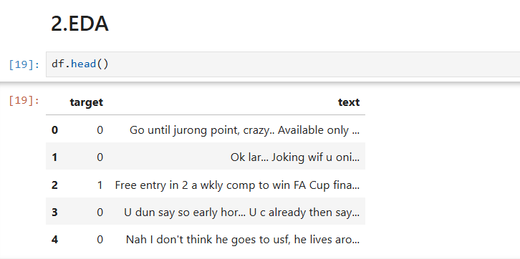

Slide 14
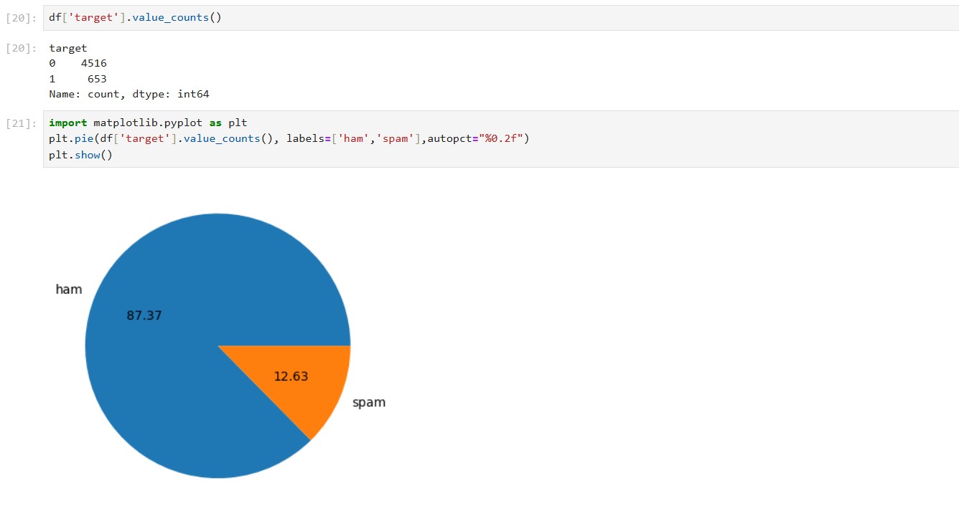
This method counts the number of occurrences of each unique value in the 'target' column.
It returns a Series where the index is the unique values and the values are the counts.
matplotlib.pyplot is a collection of functions that make matplotlib work like MATLAB.
import matplotlib.pyplot as plt:
Imports the pyplot module from matplotlib and aliases it as plt.
plt.pie(data, labels, autopct):
data: The data to plot. Here, it's the counts of 'ham' and 'spam'.
labels: The labels for each slice of the pie chart. In this case, 'ham' and 'spam'.
autopct: A string format to display the percentage value on each slice of the pie. "%0.2f" means format the percentage to two decimal places.
This function creates a pie chart of the data with the specified labels and percentage format.

Slide 15
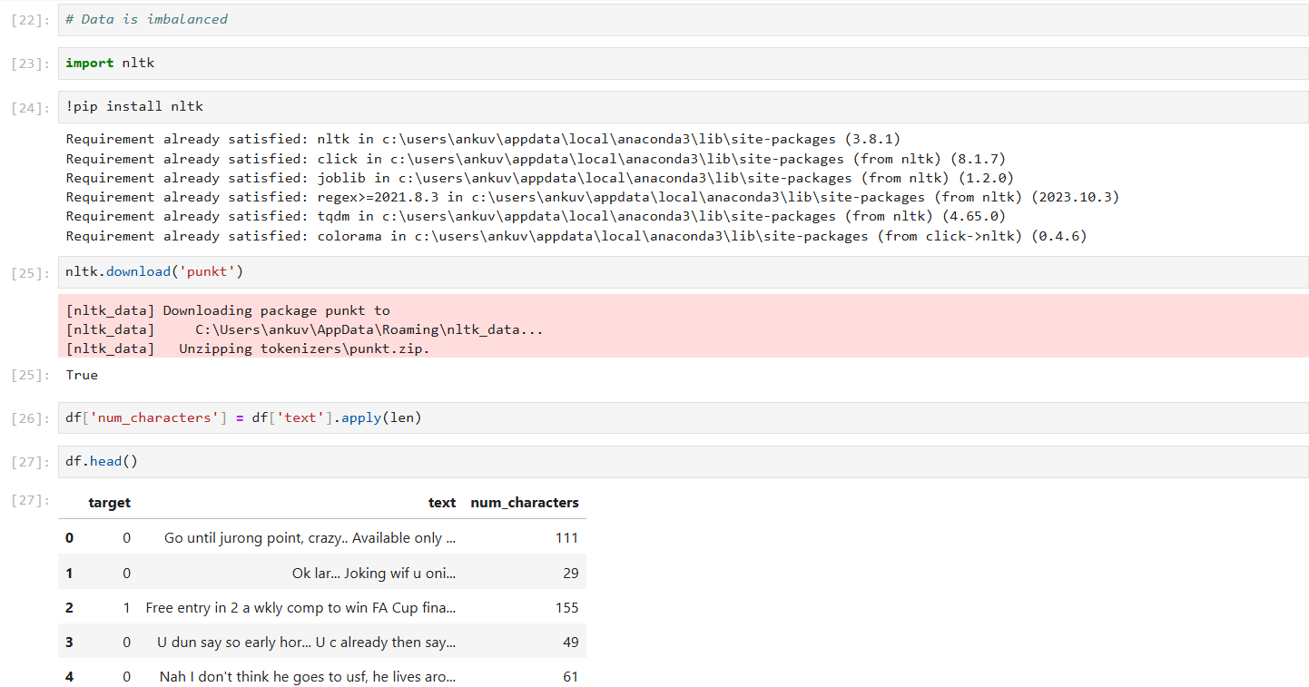
The Natural Language Toolkit (NLTK) is a library in Python for working with human language data (text). It provides easy-to-use interfaces to over 50 corpora and lexical resources, along with a suite of text processing libraries for classification, tokenization, stemming, tagging, parsing, and more.
This command installs the nltk library using the pip package manager.
The ! at the beginning is used in Jupyter notebooks to run shell commands from within the notebook.
This command downloads the 'punkt' package, which includes data required for tokenization, particularly the Punkt sentence tokenizer.
Tokenization is the process of splitting text into smaller parts, like words or sentences.
The line `df['num_characters'] = df['text'].apply(len)` adds a new column to the DataFrame `df` that contains the length (number of characters) of each text message in the 'text' column.

Slide 16
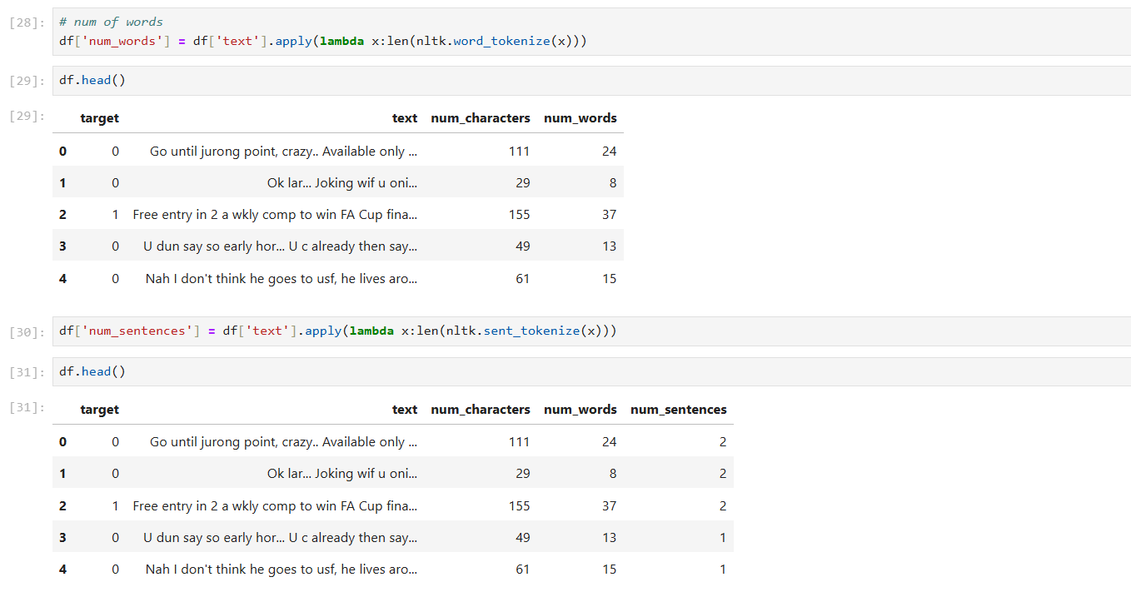
df['num_words'] = df['text'].apply(lambda x:len(nltk.word_tokenize(x)))
This line calculates the number of words in each text entry ('text' column) of the DataFrame df.
df['text'].apply(...) applies a function to each element in the 'text' column.
lambda x: len(nltk.word_tokenize(x)) is a lambda function that tokenizes (nltk.word_tokenize) the text x and returns the length of the resulting list (number of words).
So, df['num_words'] will contain the count of words for each text entry in df.
This line calculates the number of sentences in each text entry ('text' column) of the DataFrame df.
Similar to the first line, it applies a function to each element in the 'text' column (df['text'].apply(...)).
lambda x: len(nltk.sent_tokenize(x)) is another lambda function that tokenizes (nltk.sent_tokenize) the text x and returns the length of the resulting list (number of sentences).
Therefore, df['num_sentences'] will store the count of sentences for each text entry in df.

Slide 17
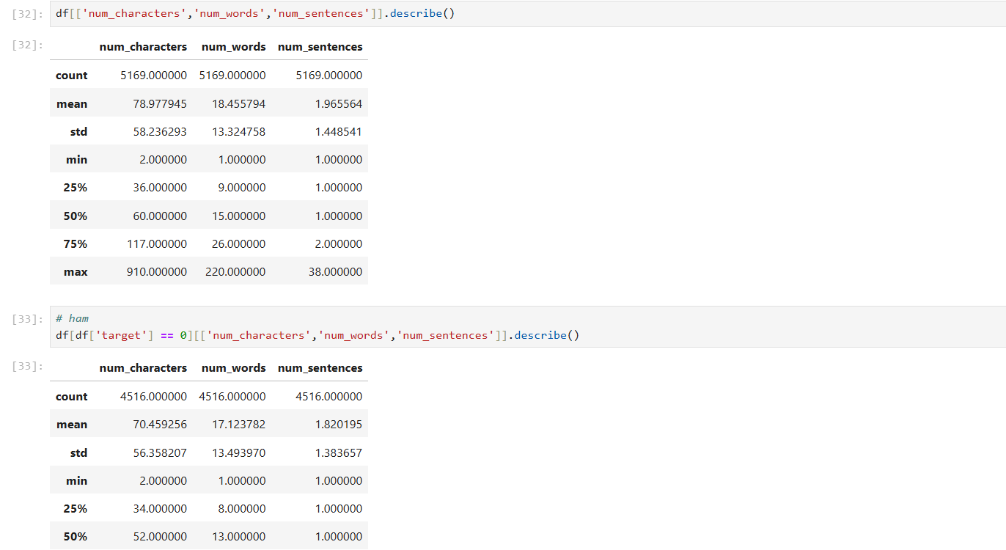
df[['num_characters','num_words','num_sentences']].describe()
This code computes descriptive statistics for three columns ('num_characters', 'num_words', 'num_sentences') in the DataFrame df.
df[['num_characters','num_words','num_sentences']] selects these three columns from the DataFrame df.
.describe() calculates summary statistics (like count, mean, standard deviation, min, 25th percentile, median, 75th percentile, and max) for each of these columns.
This code snippet includes a comment (# ham), which suggests that the subsequent line of code deals specifically with the subset of data where 'target' is equal to 0, which likely corresponds to entries labeled as 'ham' (assuming a classification scenario where 'ham' and 'spam' are labels).
df[df['target'] == 0] filters the DataFrame df to include only rows where the 'target' column equals 0.
[['num_characters','num_words','num_sentences']] then selects the columns 'num_characters', 'num_words', and 'num_sentences' from this filtered subset.
.describe() computes descriptive statistics (as explained in the first part) for these selected columns within the subset of data where 'target' is 0.

Slide 18
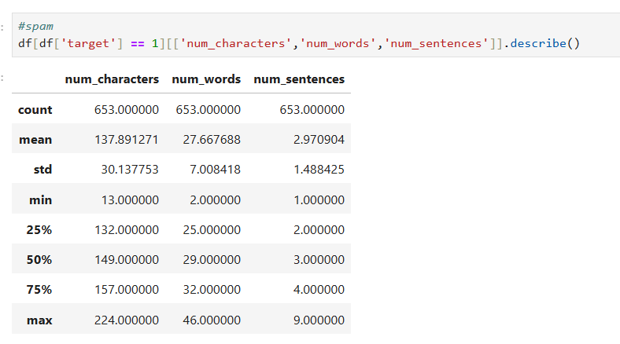

Slide 19
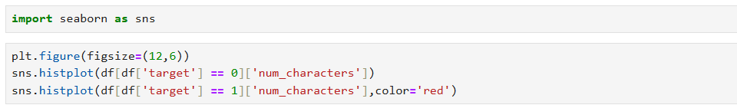
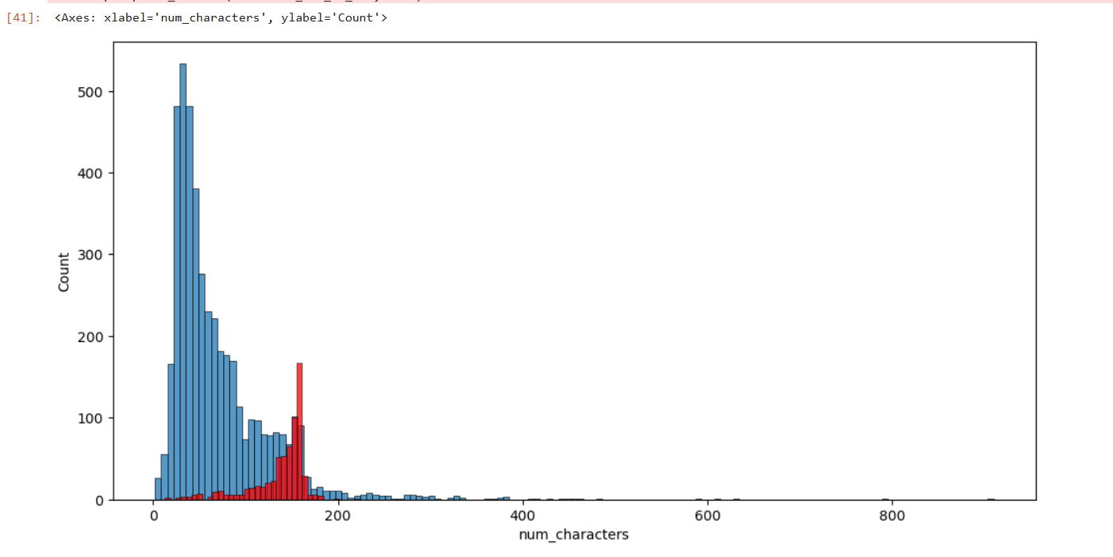
Imports the Seaborn library for statistical data visualization.
plt.figure(figsize=(12,6)): Sets the figure size for the plot to be 12 inches wide and 6 inches tall.
sns.histplot(df[df['target'] == 0]['num_characters']): Plots a histogram of 'num_characters' for rows where 'target' equals 0 (typically representing 'ham' class).
sns.histplot(df[df['target'] == 1]['num_characters'], color='red'): Plots another histogram of 'num_characters' for rows where 'target' equals 1 (typically representing 'spam' class), using red color

Slide 20
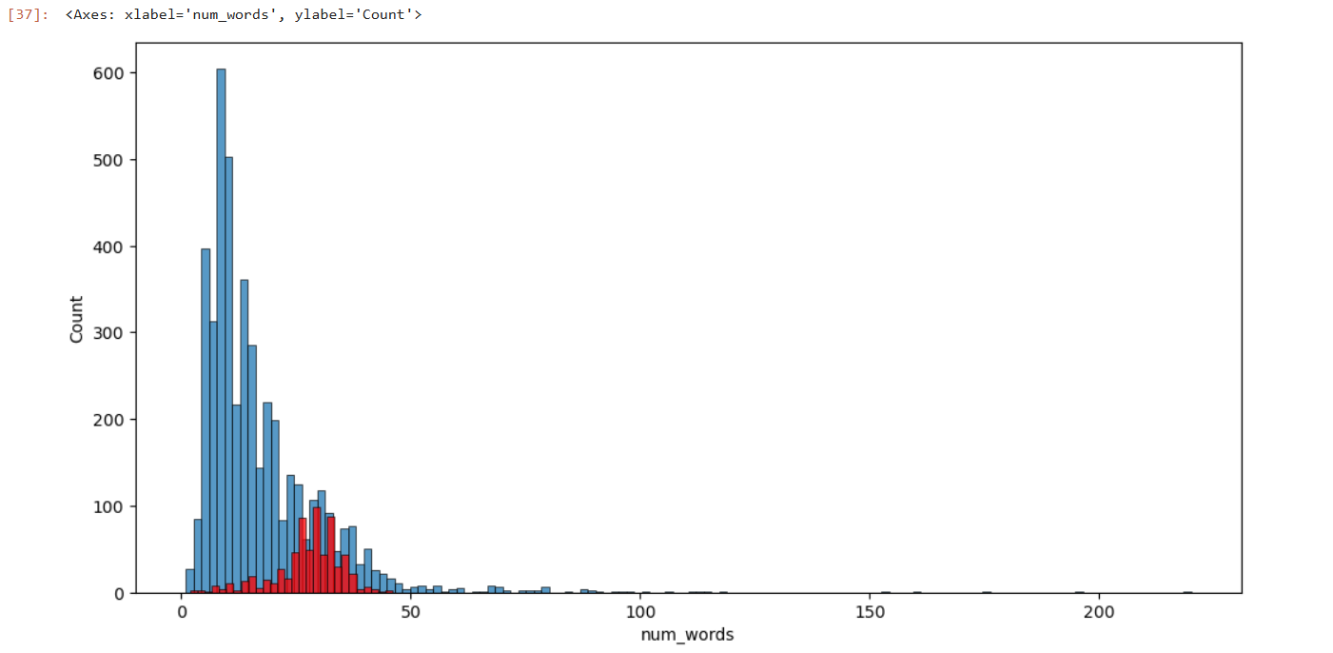

Slide 21
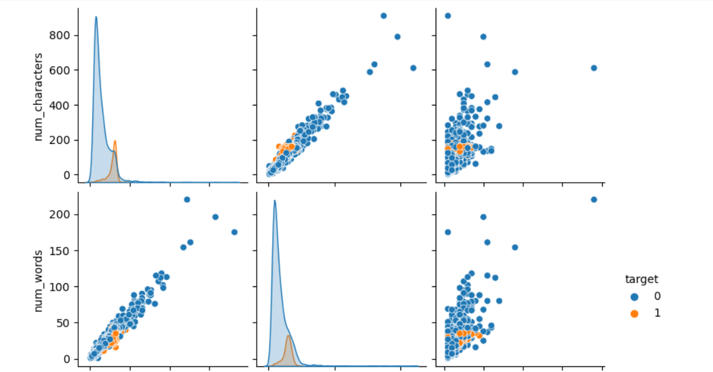
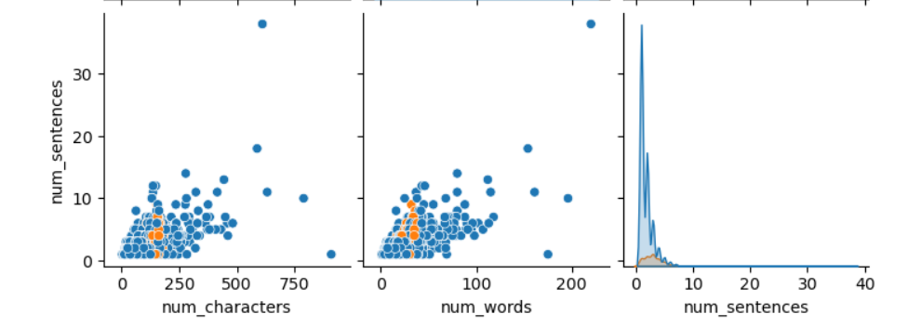
The sns.pairplot(df, hue='target') function call creates a grid of pairwise plots for numerical columns in the Data Frame df, with different colors representing different categories specified by the 'target' column.

Slide 22
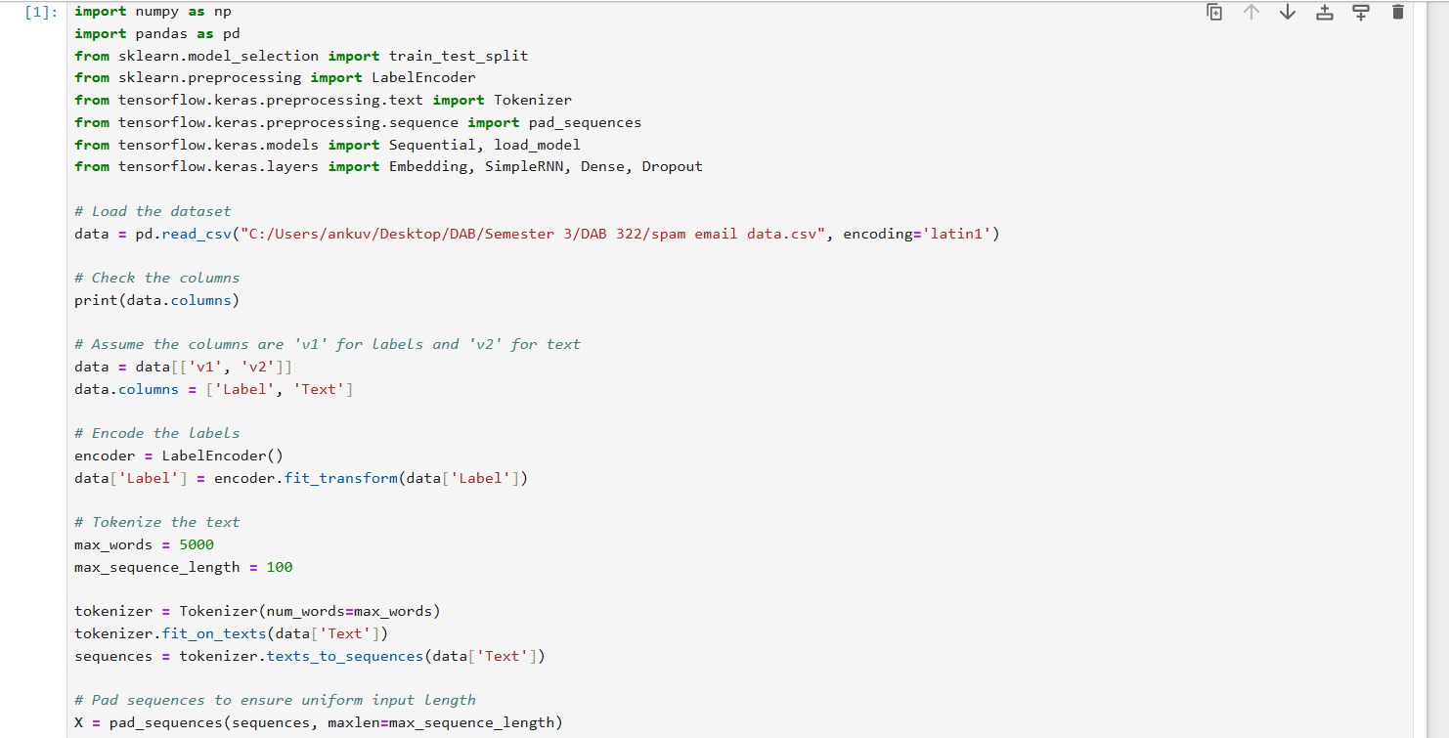
numpy (np), pandas (pd): For numerical operations and data handling.
train_test_split from sklearn.model_selection: For splitting data into training and testing sets.
LabelEncoder from sklearn.preprocessing: For encoding categorical labels into numerical format.
Tokenizer and pad_sequences from tensorflow.keras.preprocessing.text: For tokenizing text data and padding sequences to a fixed length.
Sequential, load_model from tensorflow.keras.models: For defining a sequential model and loading a pre-trained model if needed.
Embedding, SimpleRNN, Dense, Dropout from tensorflow.keras.layers: Layers needed to build the RNN model.
encoder = LabelEncoder(): Initializes a label encoder.
data['Label'] = encoder.fit_transform(data['Label']): Encodes the categorical labels ('ham' and 'spam') into numerical format (0 and 1).
Initializes a tokenizer with a maximum vocabulary size (max_words) and fits it on the text data.
Converts text into sequences of integers based on the tokenizer's vocabulary.
Pads sequences to ensure they all have the same length (max_sequence_length).

Slide 23
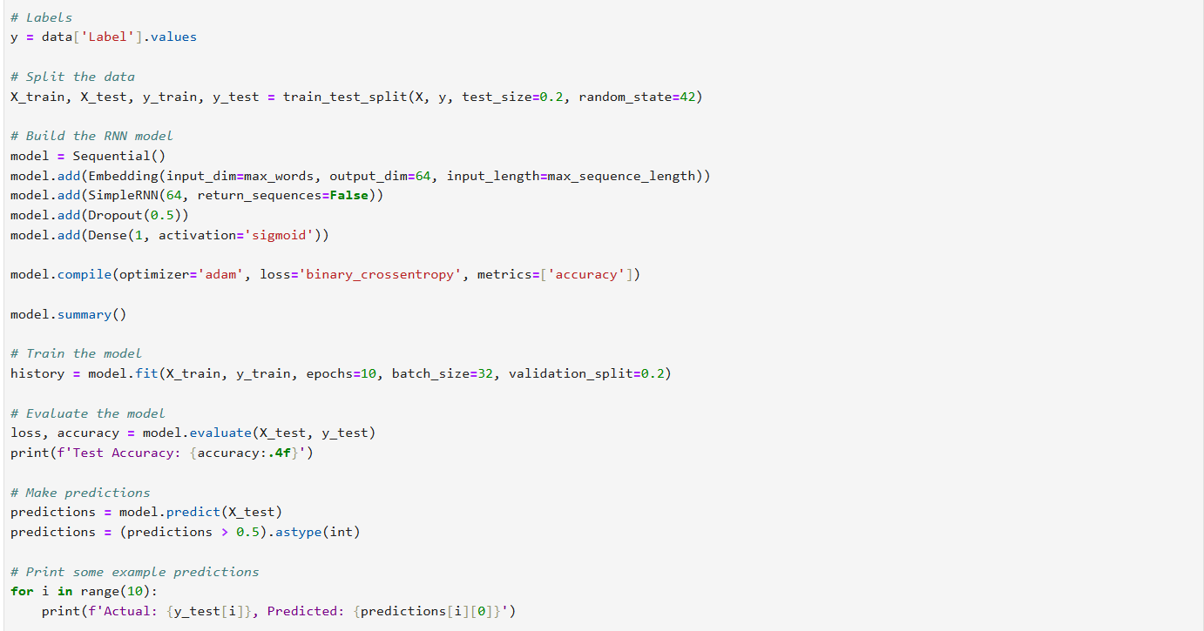
y = data['Label'].values assigns the values of the 'Label' column from the DataFrame data to the variable y
Sequential(): Initializes a sequential model.
model.add(Embedding(input_dim=max_words, output_dim=64, input_length=max_sequence_length)): Adds an embedding layer for word embeddings.
model.add(SimpleRNN(64, return_sequences=False)): Adds a Simple RNN layer with 64 units.
model.add(Dropout(0.5)): Adds a dropout layer to prevent overfitting.
model.add(Dense(1, activation='sigmoid')): Adds a dense layer with a sigmoid activation function for binary classification.
Compiles the model with Adam optimizer, binary crossentropy loss function, and accuracy metric.
Trains the model on the training data for 10 epochs with a batch size of 32, validating on 20% of the training data.
Evaluates the model on the test data and prints the test accuracy.

Slide 24
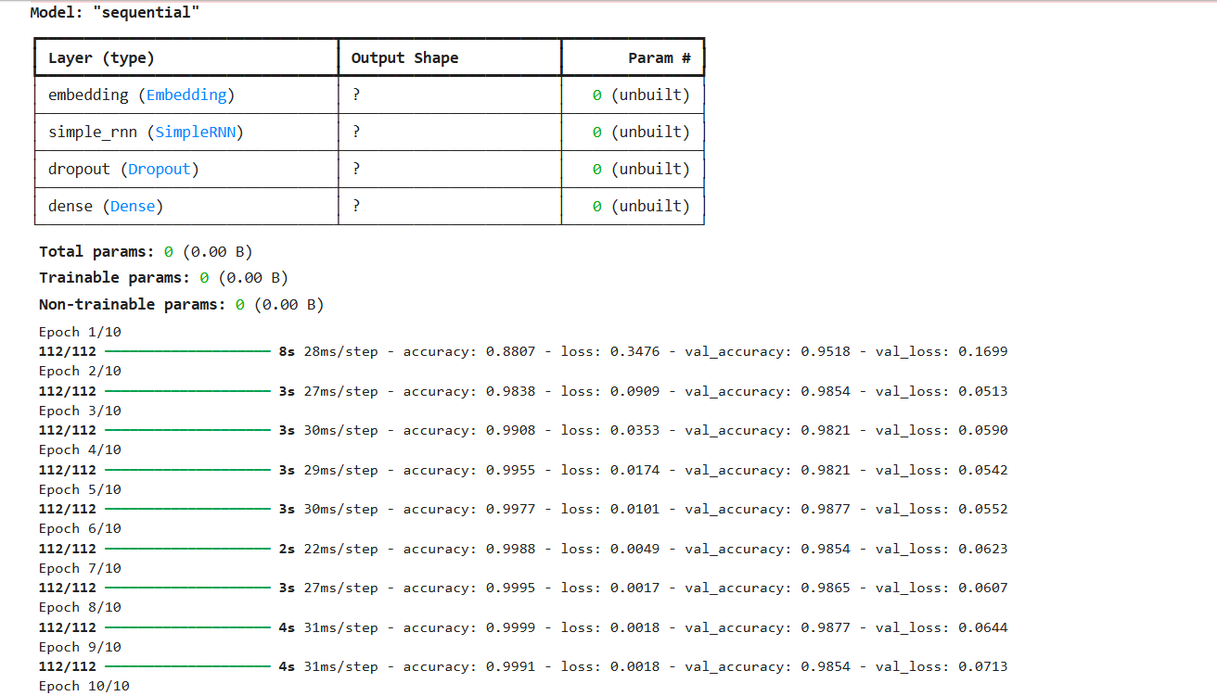
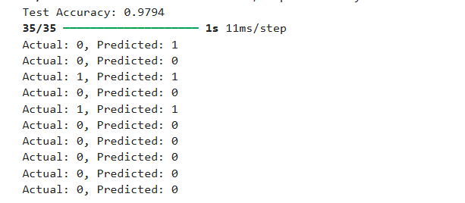

Slide 25
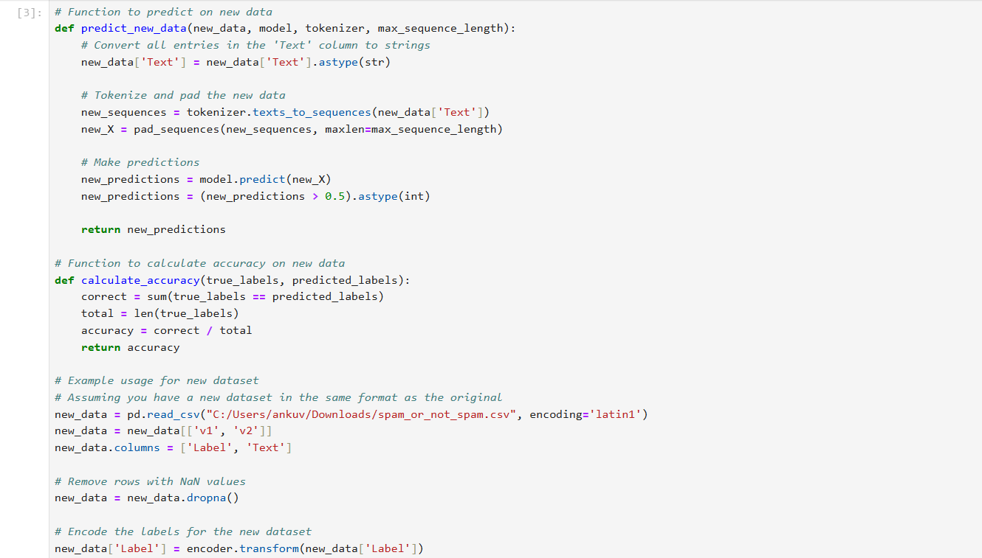

Slide 26
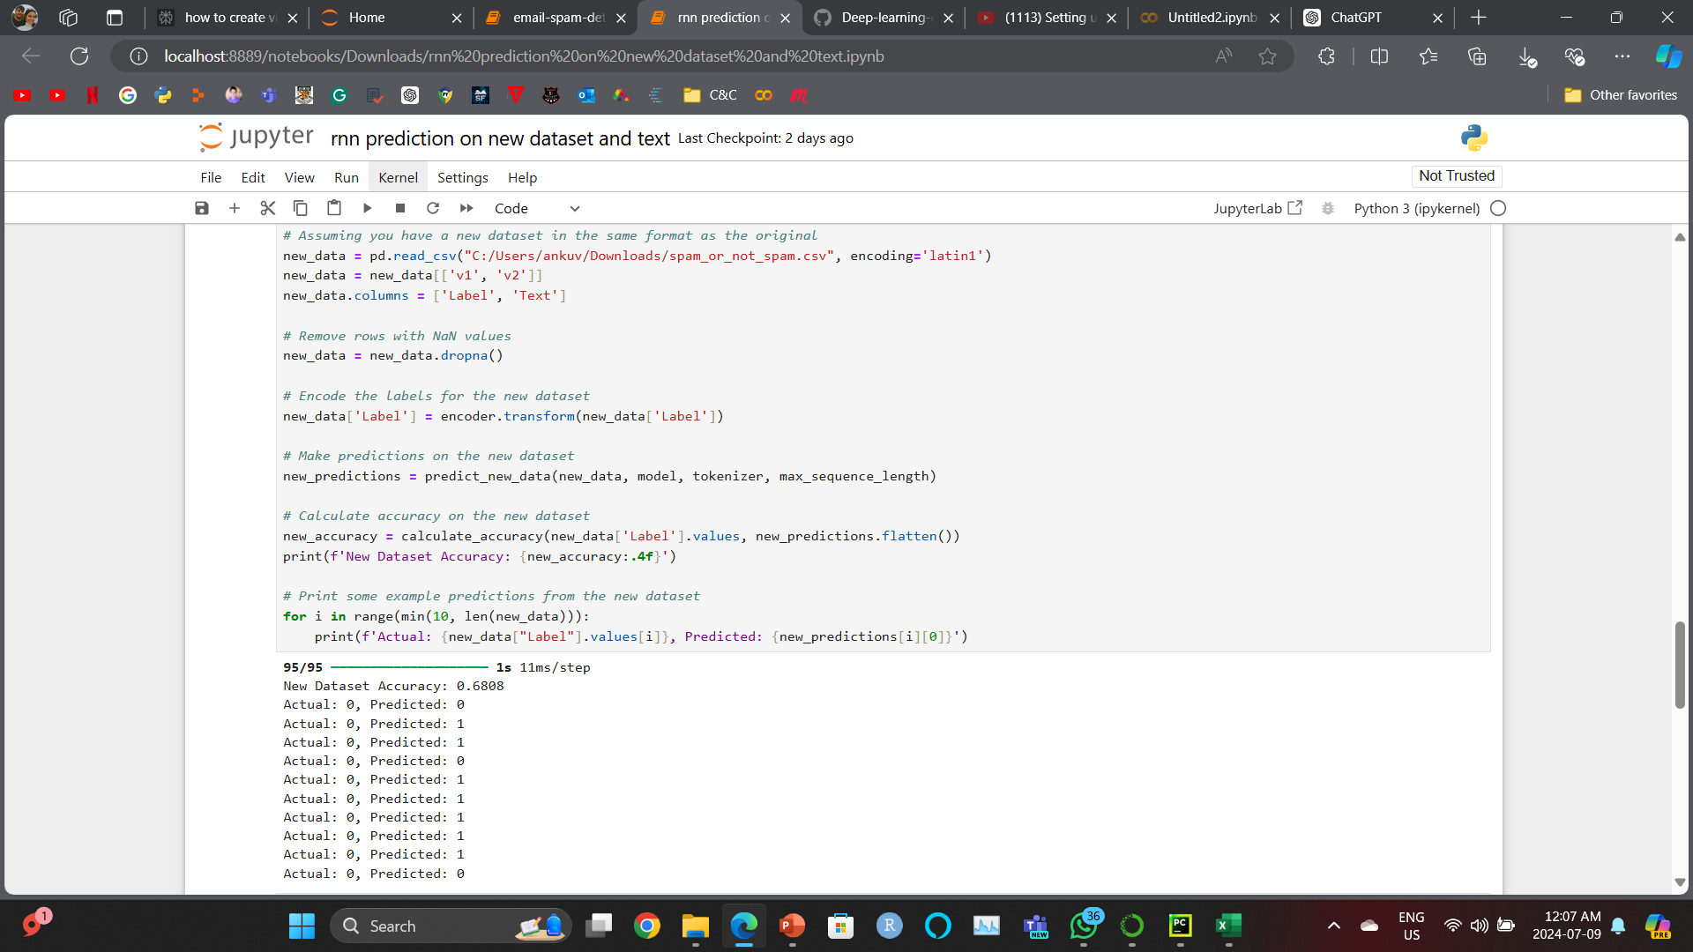

Slide 27
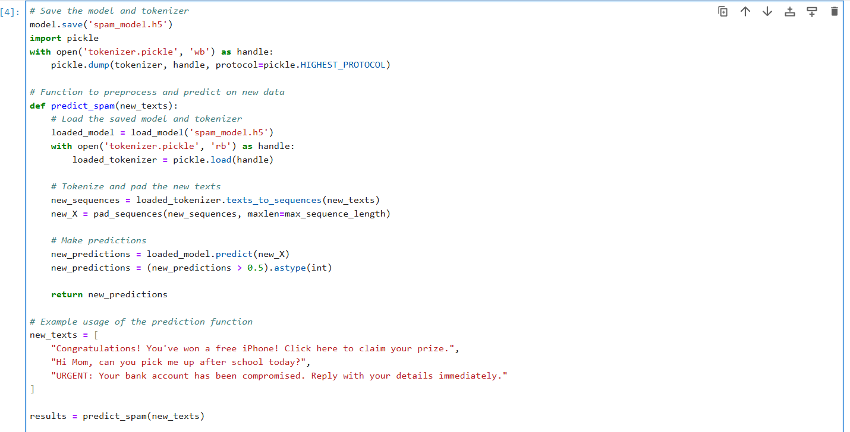

Slide 28
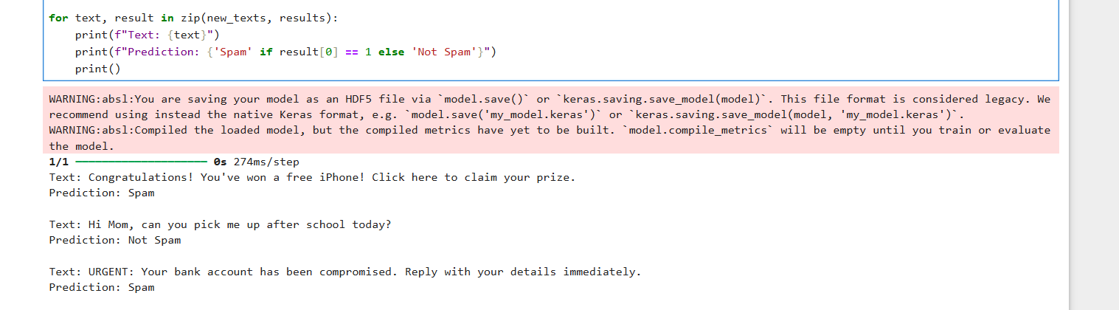

Slide 29
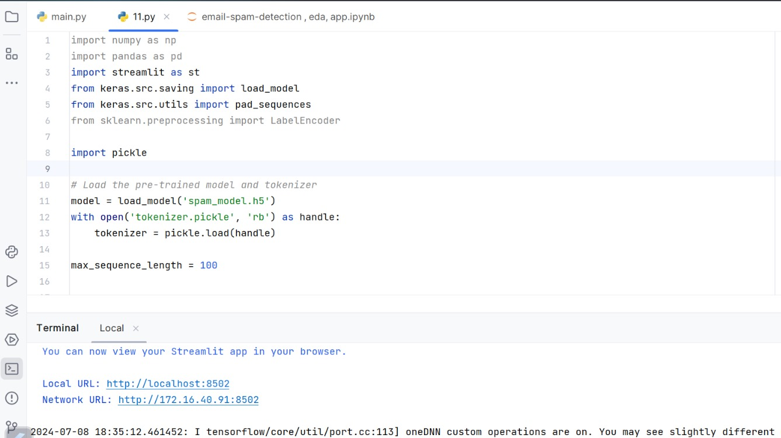

Slide 30
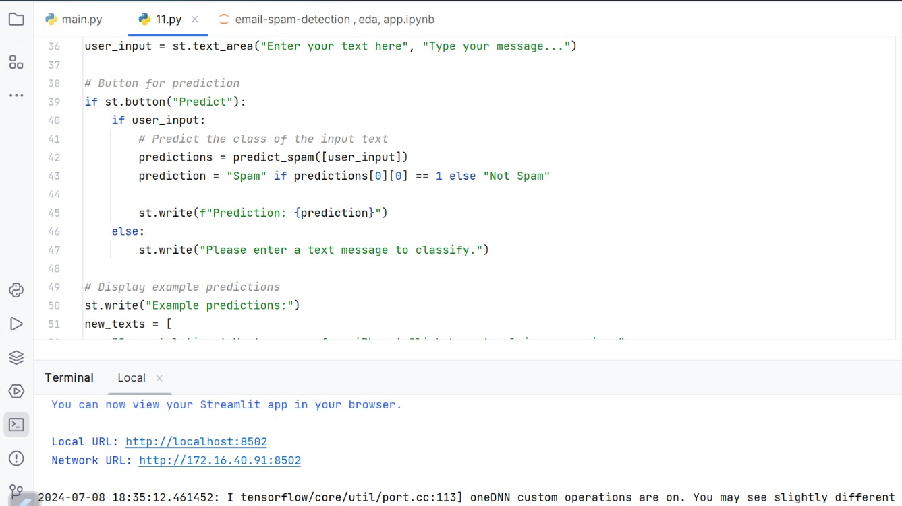

Slide 31
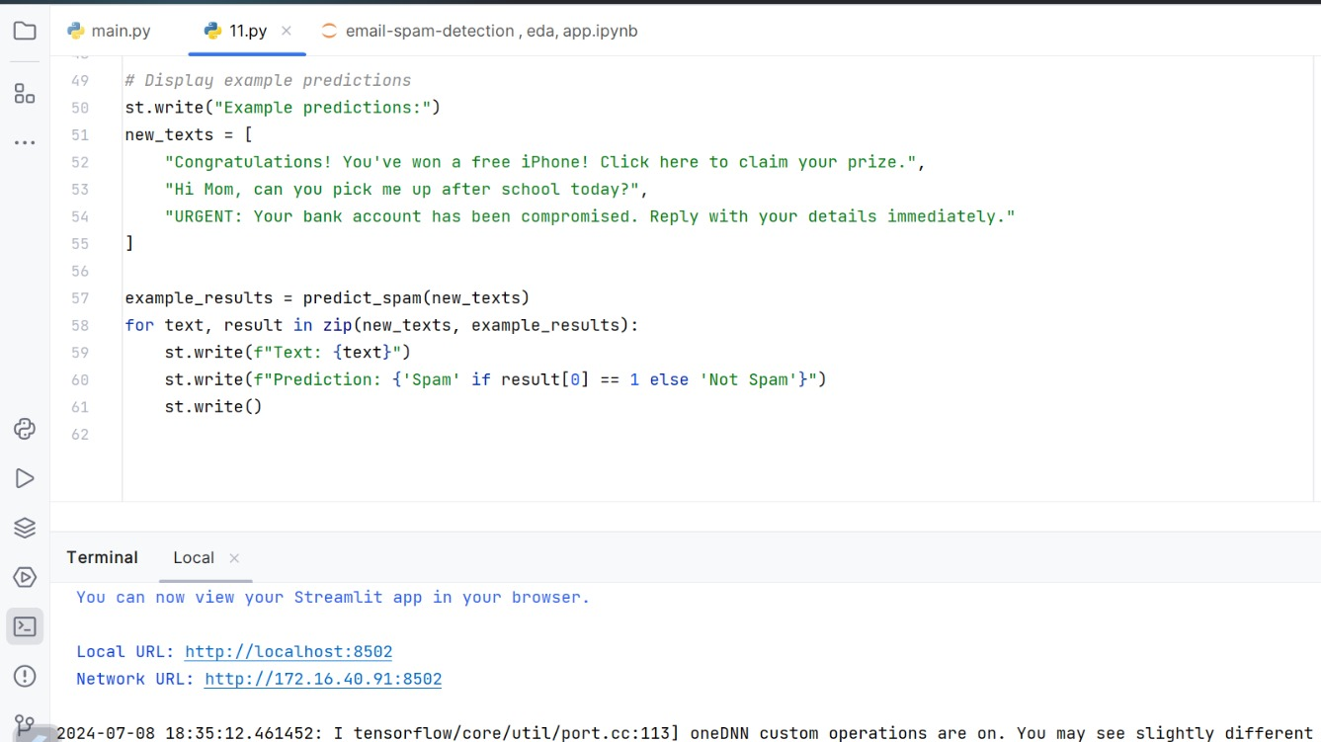

Slide 32
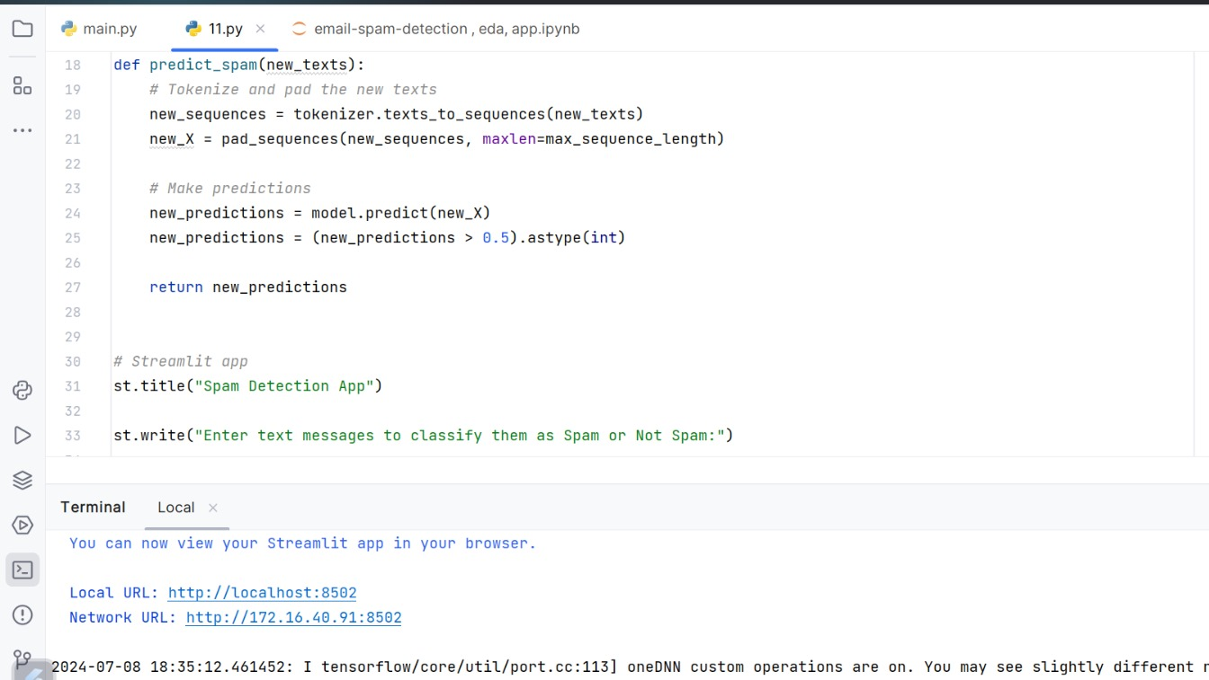

Slide 33
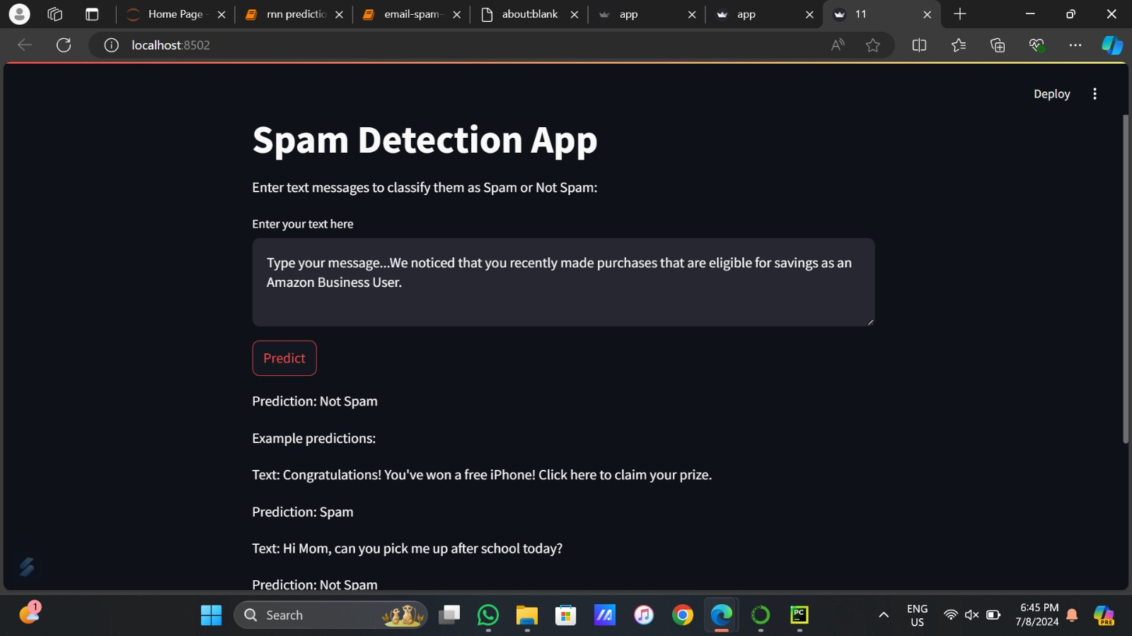

Slide 34
MACHINE LEARNING ALGORITHMS
Supervised Learning :
- Logistic Regression
- Decision Trees
- Random Forest
- Support Vector Machine (SVM)
- K-Nearest Neighbors (KNN)
- Naive Bayes
Unsupervised Learning:
- Clustering (e.g., K-means)
- Anomaly Detection
Deep Learning:
- Neural Networks
- Recurrent Neural Networks (RNN)
- Long Short-Term Memory (LSTM)
Ensemble Methods:
- Gradient Boosting Machines (GBM)
- AdaBoost
Reinforcement Learning
KEY POINTS :
- Supervised learning requires labeled data, unsupervised doesn't.
- Deep learning is powerful but needs large datasets.
- Ensemble methods often improve accuracy.
- Algorithm choice depends on use case, data availability, and computational resources.
These techniques apply to various fraud types, including financial fraud, spam emails, and anomaly detection.
Here are some of the machine learning algorithms used for fraud and spam detection:
K-Nearest Neighbors (KNN): A non-parametric method that classifies data points based on the majority class of their k nearest neighbors in the feature space.
Decision Trees (DT): A tree-like model of decisions where each internal node represents a feature, each branch represents a decision rule, and each leaf node represents an outcome.
Gradient Boosting Machines (GBM): An ensemble learning method that builds a series of weak learners (typically decision trees) sequentially, with each new model correcting errors of the previous ones.
Logistic Regression (LR): A statistical method for predicting binary outcomes by estimating the probability that an instance belongs to a particular class.
Recurrent Neural Networks (RNN): A class of artificial neural networks where connections between nodes form a directed graph along a temporal sequence, suitable for sequential data like text.
Reinforcement Learning (RL): A type of machine learning where an agent learns to make decisions by taking actions in an environment to maximize a cumulative reward.
Naive Bayes (NB): A probabilistic classifier based on applying Bayes' theorem with strong independence assumptions between the features.
Support Vector Machine (SVM): A supervised learning model that finds the optimal hyperplane to separate different classes in the feature space.
Random Forest (RF): An ensemble learning method that constructs multiple decision trees during training and outputs the mode of the classes for classification tasks.
Long Short-Term Memory (LSTM): A specific type of RNN capable of learning long-term dependencies, particularly useful for sequential data like text in emails.
These algorithms are commonly used in various combinations and with different feature selection techniques to optimize the detection of spam and fraudulent emails.
RNN model fits best, as we need to do some deep learning.

Slide 35
RNN(Recurrent Neural Networks)
About RNN Model
Benefits of using RNN model
Recurrent Neural Networks (RNNs) are a type of artificial neural network designed to work with sequential data. Here are some key points about RNNs in the context of fraud and spam detection:
Sequential Data Processing: RNNs are well-suited for analyzing sequential data like text in emails or transaction histories, making them useful for spam and fraud detection.
Memory Capability: Unlike traditional neural networks, RNNs have a "memory" that allows them to retain information from previous inputs, which is crucial for understanding context in sequences.
Long Short-Term Memory (LSTM): A popular variant of RNN that addresses the vanishing gradient problem, allowing the network to learn long-term dependencies in data.
Application in Spam Detection: RNNs can analyze the sequence of words or characters in an email to determine if it's spam, considering the context and relationships between different parts of the message.
Fraud Pattern Recognition: In fraud detection, RNNs can identify suspicious patterns in sequences of transactions or user behaviors that may indicate fraudulent activity.
Real-time Processing: RNNs can process data in real-time, making them suitable for detecting fraud or spam as it occurs.
Adaptability: RNNs can adapt to new patterns of spam or fraud over time, which is crucial as fraudsters constantly evolve their techniques.
Challenges: Training RNNs can be computationally intensive and may require large datasets for effective learning.
RNNs, especially LSTM variants, have shown promising results in spam and fraud detection tasks due to their ability to understand and remember context in sequential data, making them valuable tools in the fight against online fraud and spam.
Sequential Data Processing
RNNs are designed to handle sequential data, making them ideal for processing and analyzing the sequence of words in emails.
Contextual Understanding -
RNNs maintain a memory of previous inputs, allowing them to understand the context and relationships between different parts of an email, which is crucial for accurate classification.
Handling Variable Length Inputs -
RNNs can process input sequences of varying lengths, which is beneficial for emails that can vary significantly in size.
Shared Weights Across Time Steps -
The weights in RNNs are shared across different time steps, which helps in learning consistent patterns in the data.
Improved Accuracy -
Studies have shown that RNNs often achieve higher accuracy in email classification tasks compared to other algorithms like KNN and Back Propagation Neural Networks (BPNN).
Real-time Processing –
RNNs can be used for real-time email classification, making them suitable for applications that require immediate detection of spam or fraudulent emails.
Adaptability
RNNs can adapt to new patterns of spam or fraud over time, which is essential as spammers constantly evolve their techniques.
These advantages make RNNs a powerful tool for email classification, particularly in distinguishing between spam and legitimate emails. (Long Short-Term Memory (LSTM-1997) and Gated Recurrent Unit (GRU-2014) updates makes it the best)

Slide 36
RNN MODEL
RNN MODEL STRUCTURE
Input Layer
The input layer receives the sequence data. For text data, this often involves tokenizing the text and converting it into numerical representations (e.g., word embeddings).
Recurrent Layer
This is the core of the RNN, where the network maintains a hidden state that is updated at each time step. The recurrent layer processes one element of the sequence at a time, updating the hidden state based on the current input and the previous hidden state.
Simple RNN Cell
The basic unit of an RNN, which updates the hidden state using a simple activation function.
LSTM (Long Short-Term Memory)
An advanced RNN cell that includes mechanisms (gates) to control the flow of information, addressing the vanishing gradient problem and allowing the network to capture long-term dependencies.
GRU (Gated Recurrent Unit)
A simplified version of LSTM with fewer parameters, which also helps in capturing long-term dependencies.
Output Layer
The output layer produces the final prediction for each time step or for the entire sequence. In the context of spam detection, this could be a binary classification (spam or ham).
LAYERS IN AN RNN MODEL FOR SPAM DETECTION
Embedding Layer
Converts words into dense vectors of fixed size, capturing semantic relationships between words. This layer is crucial for handling text data.
Recurrent Layers
LSTM/GRU Layers: These layers process the sequence data, maintaining and updating the hidden state. They are more effective than simple RNN cells for capturing long-term dependencies in the data.
Stacked RNNs: Multiple RNN layers can be stacked to increase the model's capacity to learn complex patterns.
Dense (Fully Connected) Layer
After the recurrent layers, a dense layer is often used to map the high-level features extracted by the RNN to the desired output size (e.g., a single neuron with a sigmoid activation for binary classification).
Output Layer
The final layer that produces the classification result. For spam detection, this is typically a single neuron with a sigmoid activation function, outputting a probability score indicating whether the email is spam or not.
EXAMPLE WORKFLOW FOR SPAM DETECTION USING RNN
Data Preprocessing
- Clean and tokenize the text data.
- Convert text to numerical representations using embeddings.
Model Building
- Define the RNN model with embedding, LSTM/GRU, and dense layers.
- Compile the model with an appropriate loss function and optimizer.
Training
- Train the model on labelled data (spam/ham emails).
- Use techniques like early stopping to prevent overfitting.
Evaluation
- Evaluate the model on a validation set to ensure it generalizes well to unseen data.
- Use metrics like accuracy, precision, recall, and F1-score.
Prediction
- Use the trained model to classify new emails as spam or ham.
By leveraging the sequential processing capabilities of RNNs, particularly LSTM and GRU cells, spam detection models can effectively capture the context and dependencies in email text, leading to more accurate classification.

Slide 37
PRE-PROCESSING
DATA PREPROCESSING:
- Date Handling: Convert the date received column to a datetime format.
- Categorical Data: Convert categorical columns (e.g., country, province/state, solicitation method) to numerical representations using techniques like one-hot encoding or label encoding.
- Text Data: If there are any free-text columns, consider using techniques like tokenization and embedding.
- Missing Values: Handle any missing values by imputation or removing such entries, depending on their impact.
FEATURE SELECTION:
- Select the relevant features that contribute to the prediction or analysis you intend to perform with the RNN model. For instance, you might focus on columns like fraud category, solicitation method, number of victims, and financial loss.
DATA SPLITTING:
- Split the data into training, validation, and test sets to evaluate the performance of the model.
MODEL DESIGN:
- Design the RNN architecture based on the nature of the problem. For example, if you're predicting sequences or trends in fraud reports, an LSTM (Long Short-Term Memory) or GRU (Gated Recurrent Unit) might be appropriate.
- Define input shapes, layers, and other hyperparameters.
TRAINING:
- Train the RNN model using the preprocessed data and chosen architecture.
- Monitor training performance using appropriate metrics.
EVALUATION AND TUNING:
- Evaluate the model on the validation set and tune hyperparameters as needed.
- Test the final model on the test set to assess its generalization performance.
The RNN MODEL includes-
Text Cleaning:
- Remove special characters, numbers, and punctuation
- Convert all text to lowercase
Tokenization:
- Split the text into individual words or tokens
Stop Word Removal:
- Remove common words that don't contribute much to the meaning (e.g., "the", "a", "an")
Stemming or Lemmatization:
- Reduce words to their root form to decrease vocabulary size
Encoding:
- Convert text data into numerical format
- Common methods include:
- One-hot encoding
- Word embeddings (e.g., Word2Vec, GloVe)
Sequence Padding:
- Ensure all input sequences have the same length by padding shorter sequences
Data Splitting:
- Divide the dataset into training, validation, and test sets
Normalization (if using numerical features):
- Scale numerical features to a common range
Handling Imbalanced Data:
- Apply techniques like oversampling or undersampling if the spam/ham classes are imbalanced
These steps prepare the text data for input into an RNN model, ensuring it's in a suitable format for training and prediction. The specific implementation may vary depending on the dataset and model requirements.

Slide 38
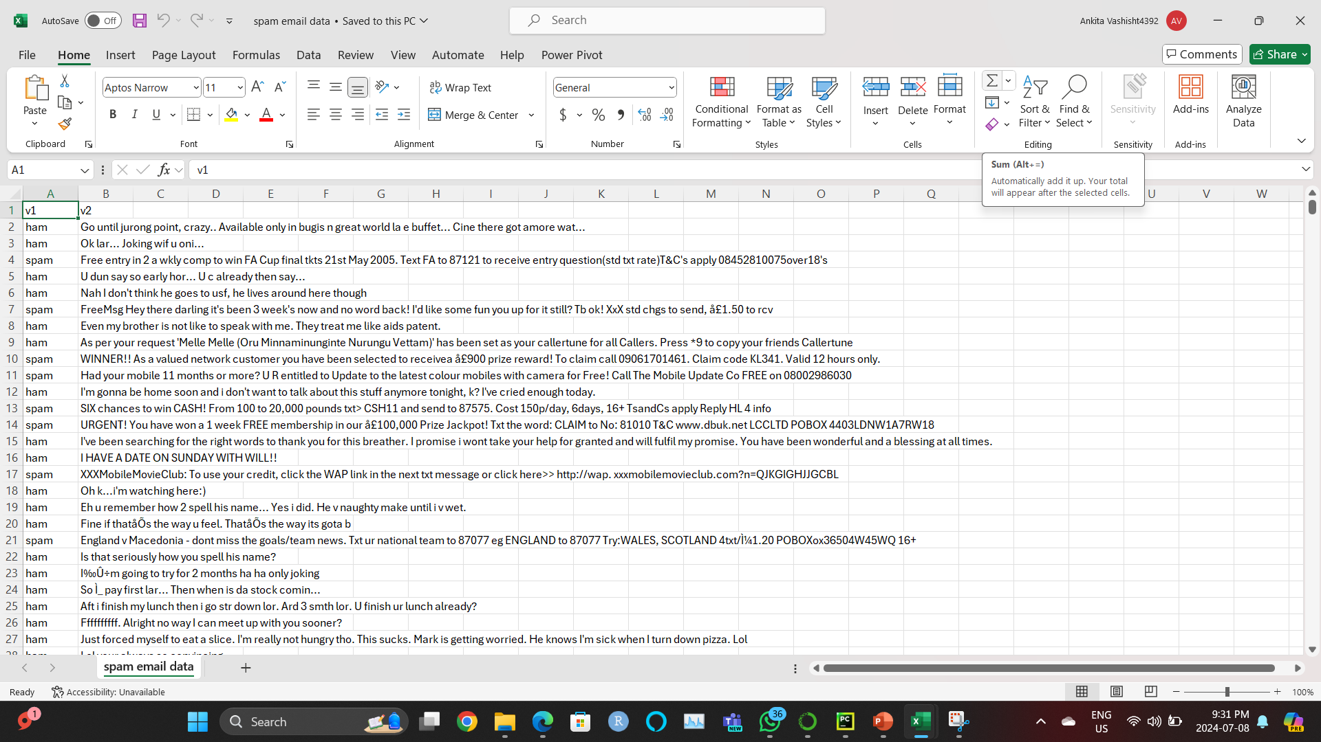
TRAINING AND TESTING
TRAINING DATASET
RNN models for spam detection typically use labeled datasets containing both spam and non-spam (ham) messages. The training data is preprocessed, tokenized, and converted into numerical sequences. The model learns to identify patterns and features that distinguish spam from legitimate messages by processing this sequential data. Training involves multiple epochs where the model's weights are adjusted using techniques like backpropagation through time (BPTT).
TESTING DATASET
A separate portion of the labeled dataset is reserved for testing. This unseen data is used to evaluate the model's performance after training. The RNN model processes the test messages and predicts whether they are spam or ham. Performance is measured using metrics such as accuracy, precision, recall, and F1-score. The testing phase helps assess how well the model generalizes to new, unseen data and its effectiveness in real-world spam detection scenarios.

Slide 39
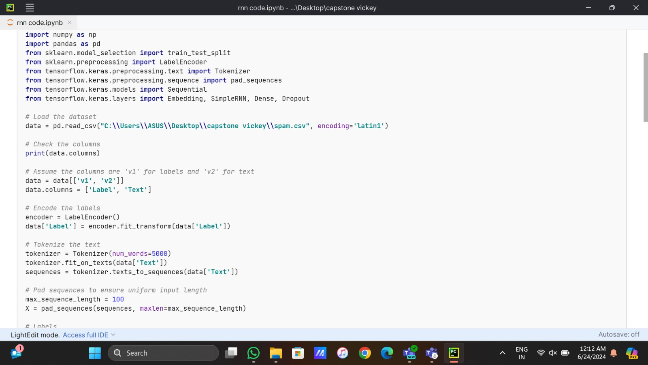
CODE
These lines import necessary libraries:
numpy (np) for numerical operations
pandas (pd) for data manipulation
train_test_split for splitting data into training and testing sets
LabelEncoder for encoding categorical labels
Tokenizer and pad_sequences for text preprocessing
Sequential for creating the model
Embedding, SimpleRNN, Dense, Dropout for building the neural network layers
This line reads the CSV file containing the spam dataset using pandas, specifying the file path and encoding.
This prints the column names of the DataFrame to check its structure.
These lines select only the 'v1' and 'v2' columns and rename them to 'Label' and 'Text' for clarity.
This creates a LabelEncoder object and uses it to encode the 'Label' column into numerical values.
These lines create a Tokenizer object (limiting to 5000 most frequent words), fit it on the text data, and convert the text to sequences of integers.
This pads the sequences to ensure all inputs have the same length (100 in this case).

Slide 40
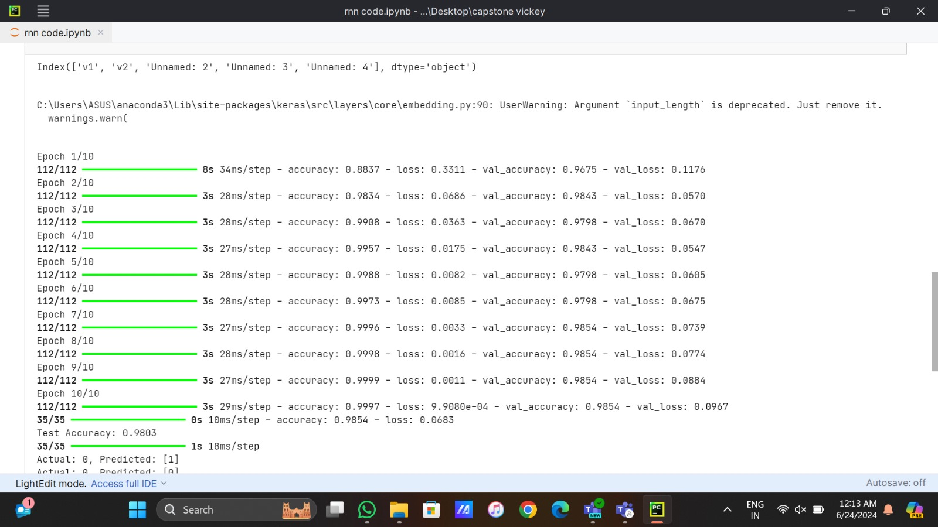
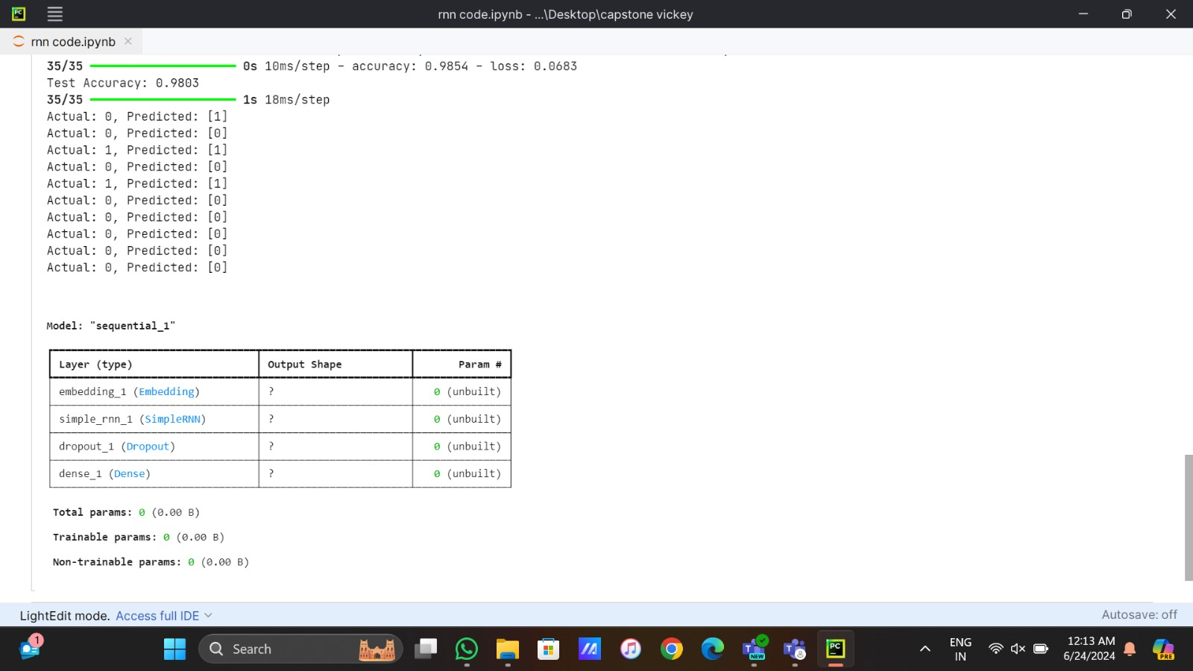
CODE
The image shows the output of the Recurrent Neural Network (RNN) training process. Here's a breakdown of the key elements that has been mentioned:
The final lines suggest that the RNN has achieved a high level of accuracy, but there's an index error related to a deprecated argument 'length', which may require code modification.
Epochs: Each epoch represents one full pass through the entire dataset. The image shows multiple epochs, indicating the progression of training over time.
Accuracy: This metric shows how well the RNN is predicting the target variable. Higher accuracy means better performance.
Loss: Loss values indicate the error between the predicted outcomes and actual values. Lower loss means the model's predictions are closer to the true values.
Validation: The validation metrics (val_accuracy and val_loss) are calculated using a separate set of data to evaluate the model's generalization ability.

Slide 41
THANK YOU

